Slide 1
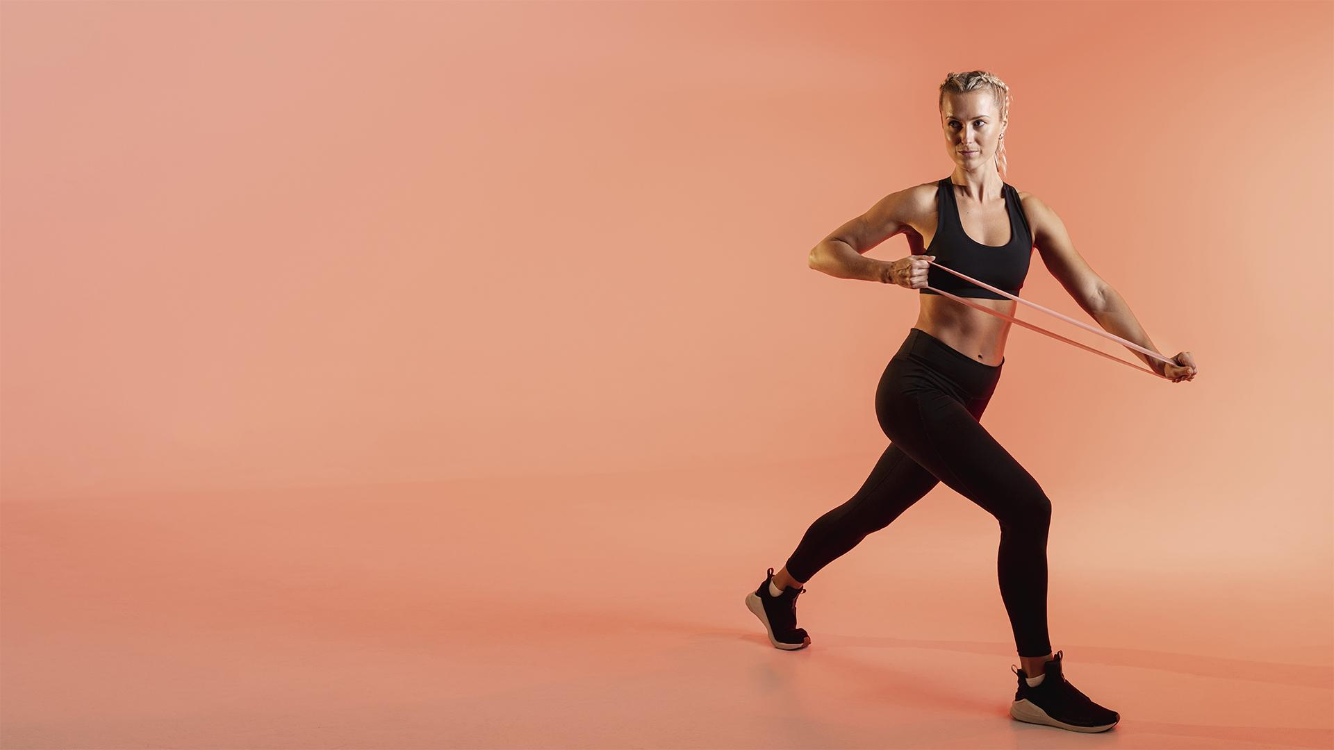
FITNESS APP
Here is where your pitch deck begins

Slide 2
Project-II Team Members
Omkar Anand Dharkar
Enrollment No. 210510110009
Roshan Vinaykumar Gupta
Enrollment No. 210510104024
Hitesh Vaishnav
Enrollment No. 210510106033

Slide 3
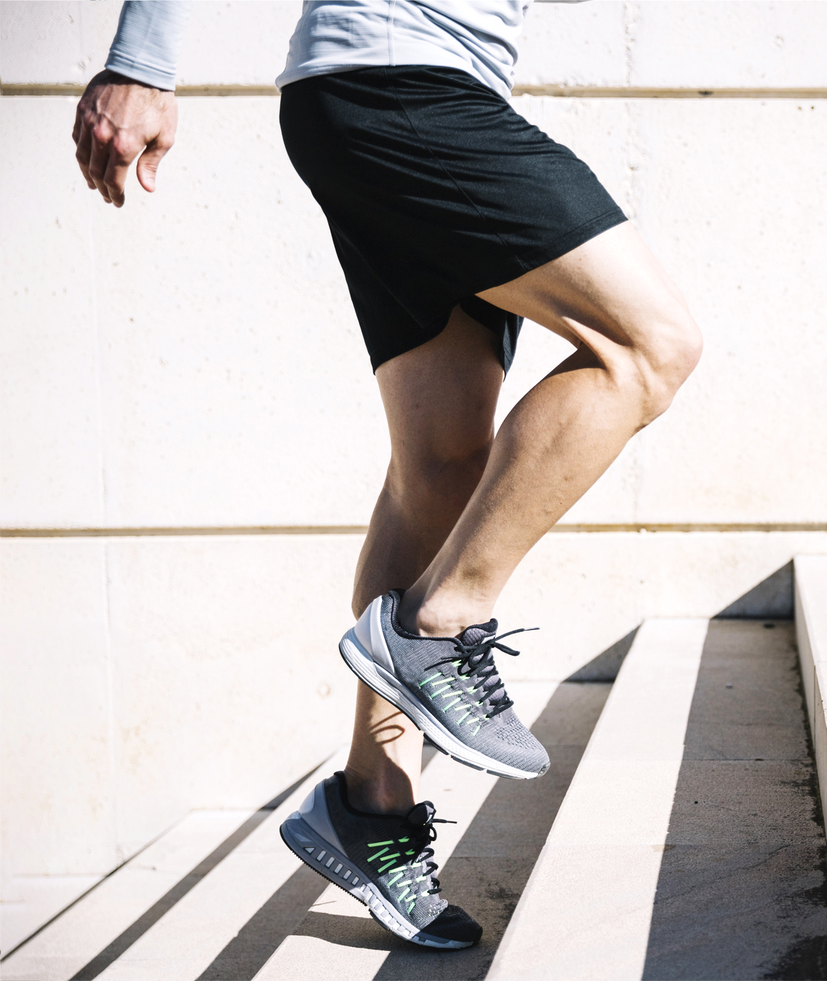
INTRODUCTION
Development of Fitness application is mainly required by People to make sure that their health is going well or not through smart phone and tablets. The main aim of this project is to facilitate People in fitness, Exercising and improving their knowledge regarding trainings. At the meantime, our app provides them diet plans. We designed the application to facilitate the users to be able to lose their weight using portable devices such as smart phones and tablets.

Slide 4
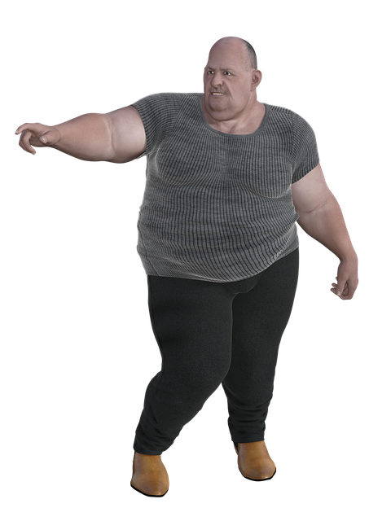
Motivation
Currently people have to travel to long for gym but due to distance and shortage of time in fast track world they can go gym regularly do they need a solution for this where they can lose their weight at home and can get diet plan paying too much

Slide 5
Scope
FITNESS APP
This Project main purpose is to develop Online fitness app named ‘Fitness King'. The application (Fitness King) will provide online exercise and notify you how many kilometers you have walked today. This application will support android and iOS based system. With this application, users or any organization can perform actions like
Administrative Task
Add or delete Exercise
Easy way to test your health.
User-friendly app for easy understanding.
Can reduce usage of time.

Slide 6
PRODUCT Design
THE APP DESIGN
Registration for the App
Login ,if user id pass valid then go to the menu.
In menu
Can choose exercises, and daily walking
Can select different modules
After selecting choice of module user get exercise instruction accordingly.
Logout

Slide 7
Advantages
User can login and see the exercise from any part of the world.
It can be used by trainers too.
No need to travel for gym so it reduces time for you.

Slide 8
Software Information
We are using Scrum methodology With Scrum, software is developed using an iterative approach in which the team is front and center—experienced and disciplined workers on smaller teams might find the most success with this method, as it requires self-organization and self-management.
We have selected Java , Javascript/NodeJS, XML.
As opposed to more traditional technologies, Javascript is a newer one but growing quickly on the server-side, and we selected it because of its stellar performance and better scalability.

Slide 9
Project timeline
Description
Time Taken
Design Android (smartphone and tablets).
Admin Area
Backend
Project management
Testing
TOTAL
1 – 1.5 weeks
2.5 -3 weeks
2.5 -3 weeks
2 - 3 weeks
1 week/
25 hours/
TOTAL 5- 6 weeks

Slide 10
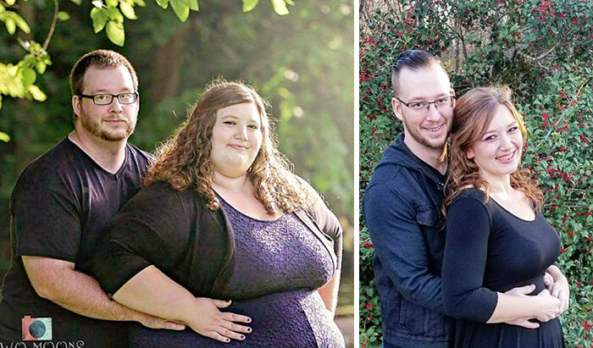
BEFORE
AFTTER
During Use of Our fitness app for atleast
3 months

Slide 11
RESOURCES
VECTORS:
Fitness mobile app infographic template flat style
Price list collection
Fitness logo template flat style
ICONS:
Gym Icon Pack

Slide 12

Fonts & colors used
#f7855b
#f3f3f3
#212121
This presentation has been made using the following fonts:
Anton
(https://fonts.google.com/specimen/Anton)
DM Sans
(https://fonts.google.com/specimen/DM+Sans)

